Slide 1
Status Report: Redfish Service Conformance Checker
Dr. Alan Sill, Robin Ronson
CAC IAB • 10.22.2018

Slide 2
Overview
Improvements in Running Time
Enhancement in Log Viewing
Identification of potential bugs
Next steps

Slide 3
About
The Redfish Conformance tool checks an operational Redfish Service API to see that it conforms to the normative statements from the Redfish specification.

Slide 4
Progress: Functional Assertions
Completed Assertions
Account Service
Actioninfo
Assembly
Boot Option
Manager
Collection Capabilities
Computer Systems
Bios
Protocol Details
Manager Account

Slide 5
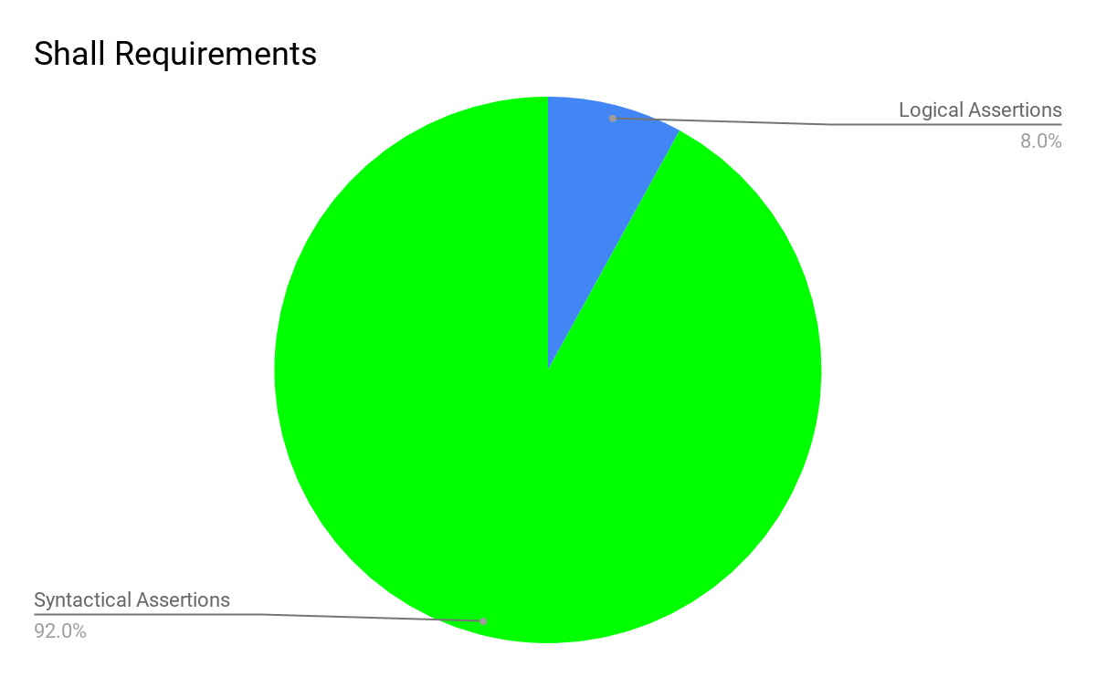
Challenge- Choosing Functional Assertions
Most shall requirements are checked by the service validator
Requirement is to identify assertions that generally requires HTTP requests

Slide 6
Progress - General
Runtime
Significant reduction in run time as a result of caching many of the HTTP GET requests.
Better debugging support as a result of caching the list of URI’s.

Slide 7
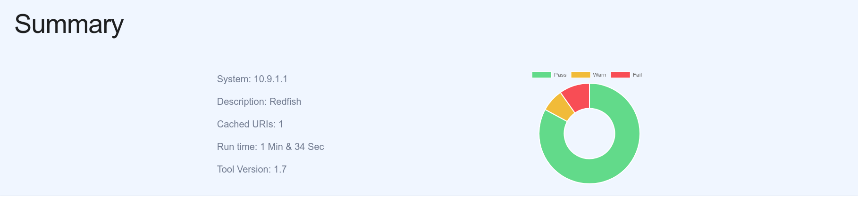
Progress - General
Log Generation
Produced JSON that could be consumed by a HTML generator
Enhanced identification of failures as a result of enhanced log generation
Fig 1.1 New summary section for Log Viewer

Slide 8
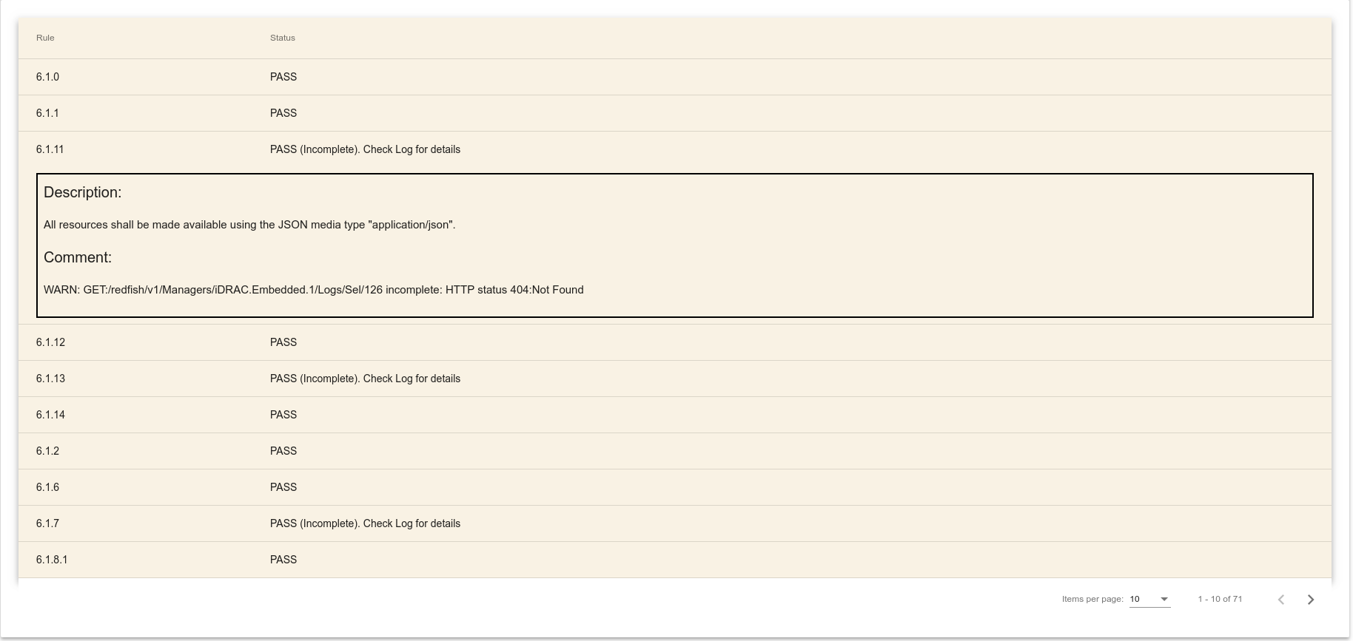
Progress - General
Fig 1.2 New assertions section for Log Viewer

Slide 9
Attention areas
Caching
Some assertions may falsely fail as a result of resources updating during testing.
Recheck failing assertions without caching.
Assertions
Security and Service Details assertions requires further development.

Slide 10
Schedule
Improvements in Security and Service Assertions
Final Report and Code Submission
Better Logging
08.15.18
10.20.18
11.10.18
12.0.18
12.20.18
Complete majority of the Assertions.
Minor Enhancements / Bug Fixes

Slide 11
Next steps
Assertions that requires completion
Event Destination:
EVEN101
EVEN100
Session Services
SESS102
SESS103
Session
SES1102

Slide 12
Questions ?

Slide 13
Thank You

